Slide 1
Structure Chart
A structure chart represents the software architecture, i.e. the various modules making up the system, the dependency (which module calls which other modules), and the parameters that are passed among the different modules.
Since the main focus in a structure chart representation is on the module structure of the software and the interactions among different modules.

Slide 2
Structure Chart represent hierarchical structure of modules.
It breaks down the entire system into lowest functional modules, describe functions and sub-functions of each module of a system to a greater detail.
Structure Chart partitions the system into black boxes (functionality of the system is known to the users but inner details are unknown).
are given to the black boxes and appropriate outputs are generated.
Modules at top level called modules at low level.
Components are read from top to bottom and left to right.
When a module calls another, it views the called module as black box, passing required parameters and receiving results.

Slide 3
The basic building blocks which are used to design structure charts are the following:
  • Rectangular boxes: Represents a module.
  • Module invocation arrows: Control is passed from one module to another module in the direction of the connecting arrow.

Slide 4
• Data flow arrows: Arrows are annotated with data name; named data passes from one module to another module in the direction of the arrow.
• Library modules: Represented by a rectangle with double edges.
• Selection: Represented by a diamond symbol.
• Repetition: Represented by a loop around the control flow arrow.

Slide 5
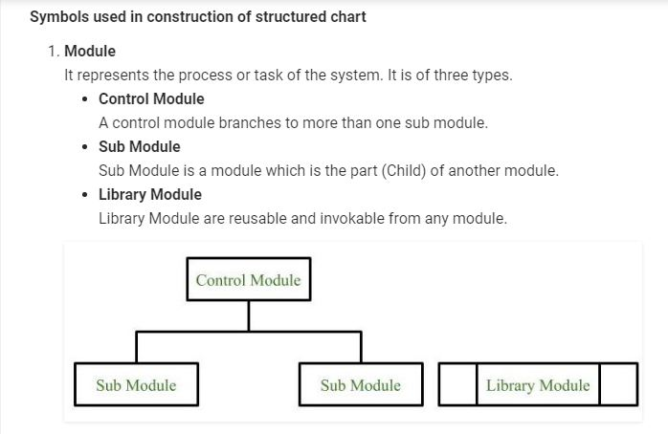

Slide 6
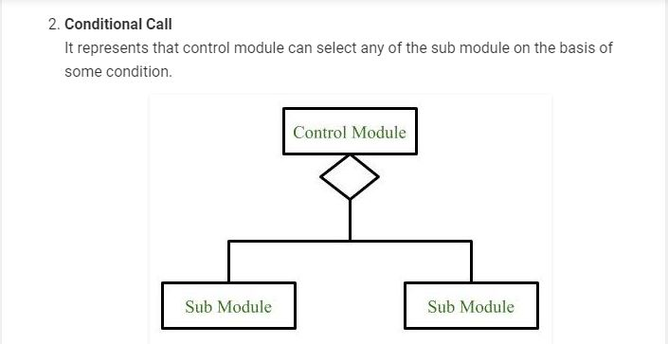

Slide 7
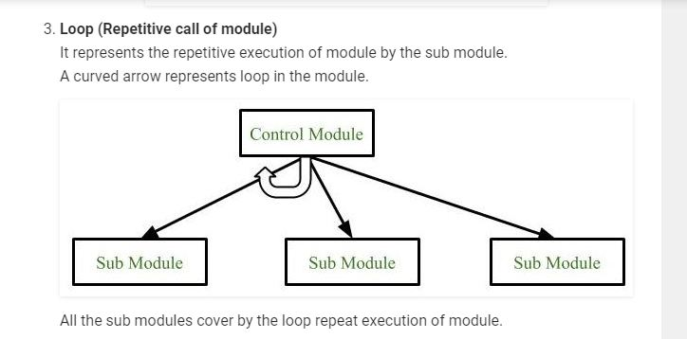

Slide 8
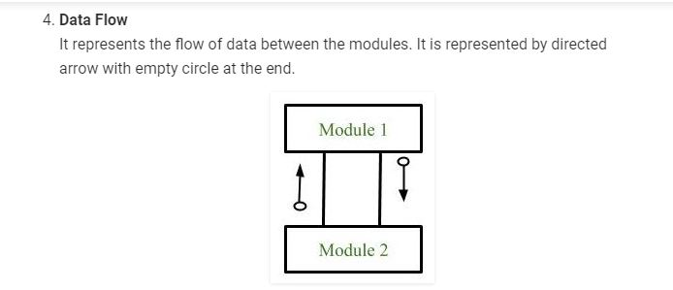

Slide 9
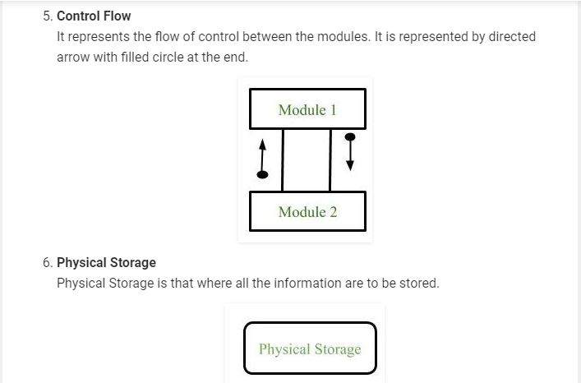

Slide 10
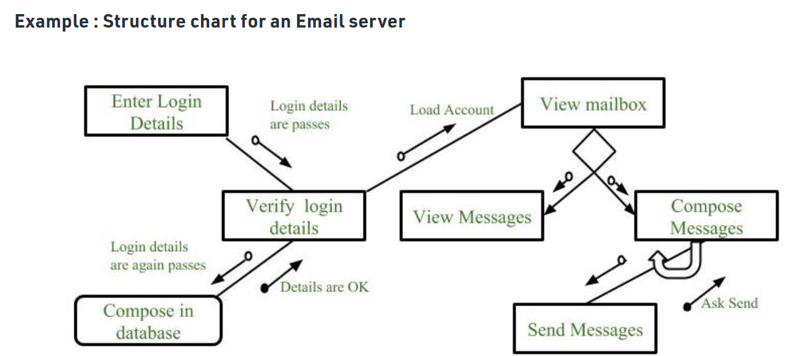

Slide 11
Structure Chart vs. Flow Chart
We are all familiar with the flow chart representation of a program. Flow chart is a convenient technique to represent the flow of control in a program. A structure chart differs from a flow chart in three principal ways:
  • It is usually difficult to identify the different modules of the software from its flow chart representation.
  • Data interchange among different modules is not represented in a flow chart.
  • Sequential ordering of tasks inherent in a flow chart is suppressed in a structure chart.

